Slide 1
Project 3 - Ames Housing
By Elke Hansen

Slide 2
Key Steps to Predict Sale Price
Clean the Data
Visualise
Select Variables
Split training and testing sets
Create Model
Evaluate model

Slide 3


Cleaning the Data
Tried to do as much of this as possible to the main dataset regardless of whether it would be used in Part 1 or Part 2
Fill NAs with 4 types: None, No, 0, imputation
Is this effort to fill the NAs necessary?
Inspect data types of the columns and change where appropriate
Creation of new ‘age’ columns:

Slide 4
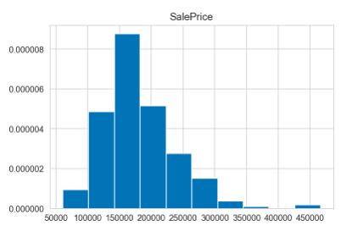
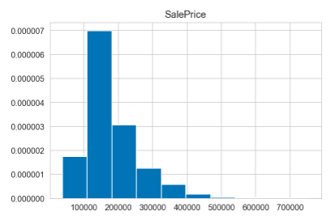
Imputation of
Missing Values
Lot Frontage Missing Values
From inspecting some of the other variables where LotFrontage is NA, this should not be zero value and should be replaced with a numerical value of some sort
When comparing the histograms of the SalePrice of the values we do have and those we don’t, it is clear mean also should not be used
Created a model using top 6 correlated features with LotFrontage which had an R squared of 0.92
Use this model to predict the missing values in this column
Lot Frontage Filled Values

Slide 5
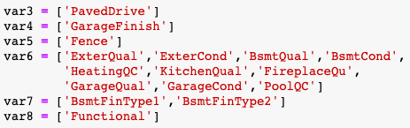
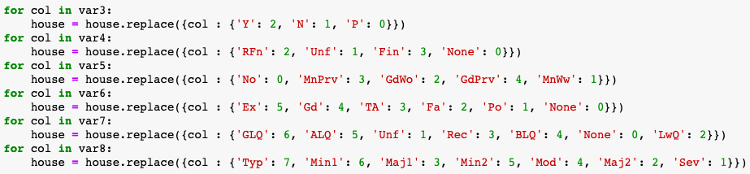
Dealing with ‘rating’ categorical variables
--------> 5
--------> 4
--------> 3
--------> 2
--------> 1
--------> 0
Ex Excellent
Gd Good
TA Average/Typical
Fa Fair
Po Poor
None

Slide 6
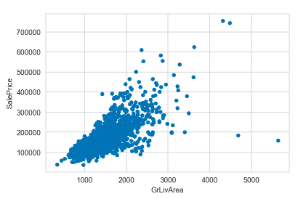
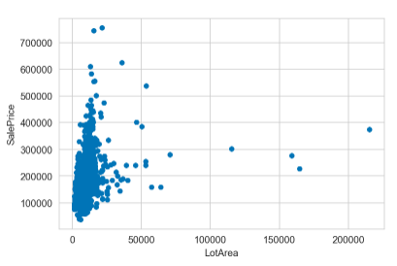
Removal of Outliers
After looking at the description table of the variables, I decided to take a look at GrLivArea and LotArea
These were the variables that had extreme max values and standard deviations
Removed GrLivArea > 4,500
Removed LotArea > 100,000

Slide 7
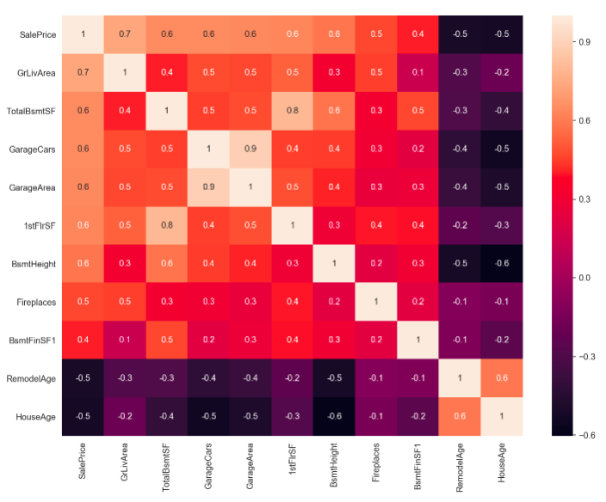
Feature Selection Using Correlation
Looked at correlation of fixed variables with SalePrice
Selected only those with a correlation magnitude of more than 0.4
Created a heatmap of these variables
Removed variables highly correlated with the others to avoid multicollinearity

Slide 8
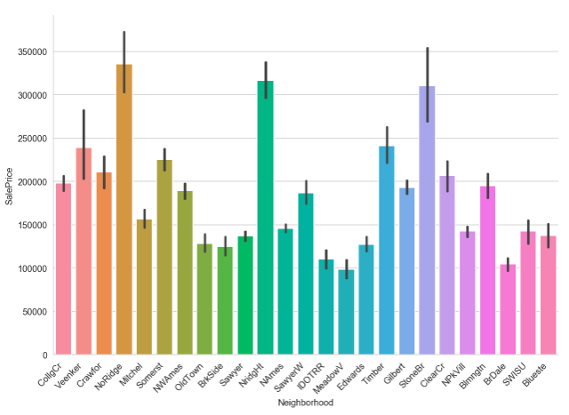
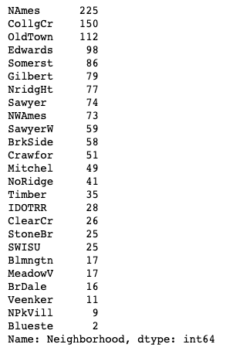
Inspection of Neighbourhoods - Location, Location
Good variation across mean prices as well as number of values per category

Slide 9
Models - Trial and Error
Returned an R squared of 0.544 off one variable but many of the p values were too high
Returned an R squared of 0.788, all p values = ~ 0.00
Returned an R squared of 0.815, all p values < 0.05
Returned an R squared of 0.850, all p values < 0.05. Keep this as final model

Slide 10
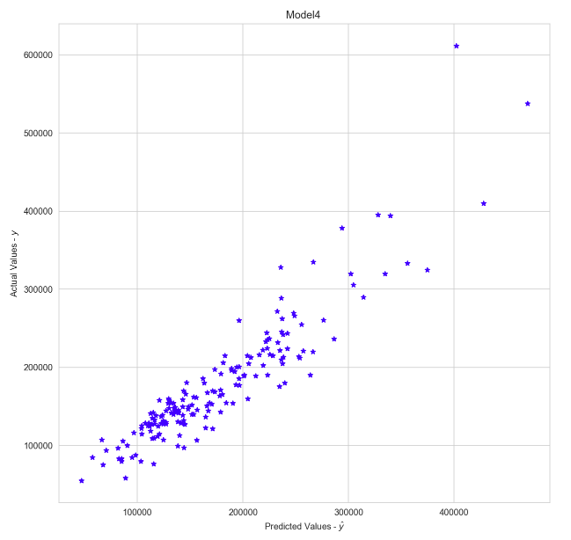
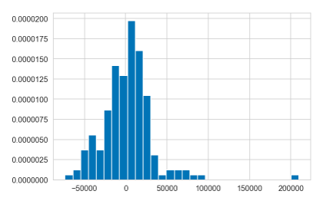
Model 4 - Plotting Residuals
Scatterplot of residuals looks good but you can see there are some significant under - predictions shown more clearly in the histogram

Slide 11
Predicting Residuals - Preprocessing
Remove residuals above $150,000 to get a more evenly distributed target
Engineer some new features from discrete variables:
ExterScore = ExterQual * ExterCond
BsmtScore = BsmtCond * BsmtFinType1 * BsmtFinType2
GarageScore = GarageFinish * GarageQual
Bathrooms = FullBath + HalfBath * 0.5
Select renovatable features: some ‘non-fixed’ features such as overall condition should not be used as they are too vague
Repeat correlation feature selection process
Dummy out categorical variables with good variance - probably did too many!

Slide 12
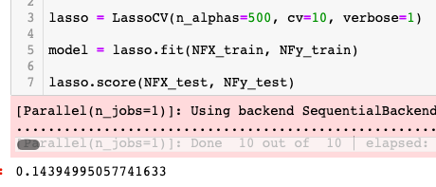
Modelling Trials
Scale Features for Feature Selection Models
Ridge Regression gave a score of 0.142
Lasso did slightly better:

Slide 13
Suggestions for Renovations
Change RoofStyle to Gable = $5,846 (Highly unlikely to be profitable)
Additional Quality Point to Kitchen = $5,292 (Possible)
Add in a bathroom = $4,360 (Possible)
Additional Condition Point to Basement = $4,016 (Potentially Cheapest)
Change RoofStyle to Hip = $3223 (Highly unlikely to be profitable)
Update Masonry Veneer to Brick = $2,669 (Highly unlikely to be profitable)
Additional Bedroom Above Ground = $2,298 (Highly unlikely to be profitable)
Improve Exterior Condition by one point = $1,743
Improve Garage Score by one point = $1434
Improve Heating Quality by one point = $1,261

